Slide 1
Agenda
Operating System
Services
Categories

Slide 2


Definition
Service:
A system or organization that provides to the public with something that it needs or the job that an organization does.
Satisfy the user and system requirements
Services will available as per the request or automatically
Examples:-Mobile service, postal, LIC, Market Call, mobile quality service and many more…..
As we know operating system is service provider in computer system.
Operating System provides many services that are usually categories into user and system perspective.
OS satisfy the user and system both hence OS called as “All in All”
Operating System services may vary from system to system.

Slide 3
OS Services Categories
Purpose :-
It provides users the services run various programs in a convenient manner.
Operating system services are responsible for the management of platform resources, including the processor, memory, files, and input and output.
They generally shield applications from the implementation details of the machine.
OS Service categories into user and system perspective.
User Perspective Services:-
Program execution
Input / Output operation
File system manipulation
Process communication
User interface
Error detection
System Perspective services:-
Resource allocation
Accounting
Protection

Slide 4
Thank You
We will meet Soon!!!!!!!!!!

Slide 5
Agenda
Operating System
Services
To User’s
User Perspective Services:-
Program execution
Input / Output operation
File system manipulation
Process communication
User interface
Error detection

Slide 6
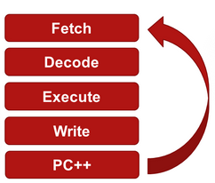
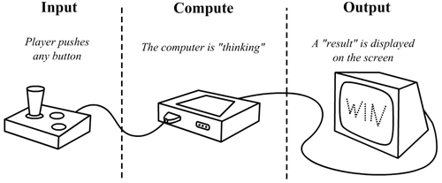
Program Execution
Program consists of set of instruction in passive form that needs to be executed by central processing element (CPU) CPU has ALU for the same.
For execution of any program the content of program should be loaded into main memory, after that execution is possible.
For program the allocation and de-allocation of memory is done by operating system itself.
Executable environment is provided by the operating system itself.
Provides a mechanism for process synchronization.
Provides a mechanism for process communication.
Provides a mechanism for deadlock handling
Once the process done
The program must be able to end its execution,
Either normally or abnormally / forcefully.

Slide 7
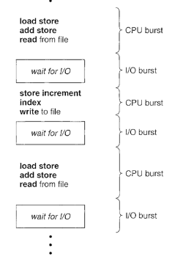
Input / Output operation
While execution of any program, many times, it requires some I/O devices for subsequent execution. (For example reads or write operation).
All programs have their CPU burst and IO burst while execution program goes
through both the burst for successful execution.
After CPU burst there is an IO burst to many programs.
That I/O device (I/O burst) is provided by OS itself.
User need not to control the I/O operation (allocation, release, use).
Both the burst required context switch from CPU to IO for small amount of time.

Slide 8
File system manipulation
File is a logical structure to store data on secondary storage where programs contents can be resides.
User can write program contents in file and need not to worry about the content stored/write on secondary storage because Operating System keeps track of all such memory location, so that it will not get overlapped or override with other user data content.
Hence user gets its own copy without any hazard.
Operating System provides an interface to the user to create/delete files.
Program needs to read a file or write a file.
User can update/modify the file
The operating system gives the permission to the program for operation on file.
Permission varies from read-only, read-write, denied and so on.
Operating System provides an interface to the user to create/delete directories.
Operating System provides an interface to create the backup of file system.
Generally system have file system formats like FAT, FAT32, exFAT, NTFS etc Each file system has its own formatting style.

Slide 9
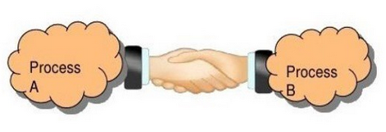
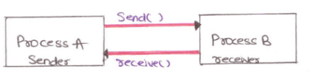
Process communication
There are two nature of process Independent and Dependent process
Process needs to swap over information with other process. Processes executing on same computer system or on different computer systems can communicate using operating system support.
During the execution of program it required some value from other program, which requires (if co-operating process) interaction among/between both processes to produce the O/P.
Such a process communication is provided by operating system through standard mechanism like
IPC, socket, pipe, shared memory, message passing [for DOS] as a utility or mechanism which leads to proper communication among the processes.
When co-operating process execute it affect other processes and also their output, depending on other process contents so proper synchronization is required.
For the same some primitives are required to handle such activity, otherwise it wouldn’t have been any sequential execution

Slide 10
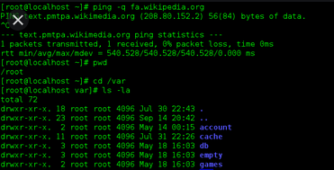
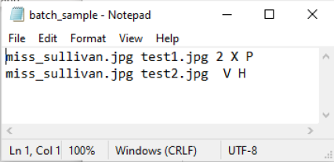
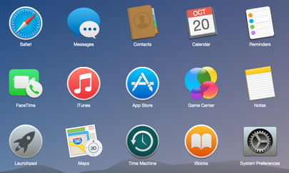
User Interface
As a definition of operating system it provide a way to interact with hardware
Command line interface—single
Batch based interface—Multiple
Graphical User Interface/UI---Icons

Slide 11


Error detection
Every process (during execution) is a sensitive issue because during execution the contents of program resides in main memory, and most of the time it transfer from one place to another place, which may lead to some hazard.
Operating System keeps track of resources to monitors is there a normal operation or not.
Operating system takes a corrective action after detection of an error and shows the error message to user so that user will know that error has occurred in system.
Errors can occur anytime and anywhere.
An error may occur in user program CPU, in I/O devices or in the memory hardware during operation.
For each type of error:-
• The OS constantly checks for possible errors.
• The OS takes an appropriate action to ensure correct and consistent computing.

Slide 12
Thank You
We will meet Soon!!!!!!!!!!

Slide 13
Agenda
Operating System
Services
To System/Program
Resource allocation
Accounting
Protection

Slide 14
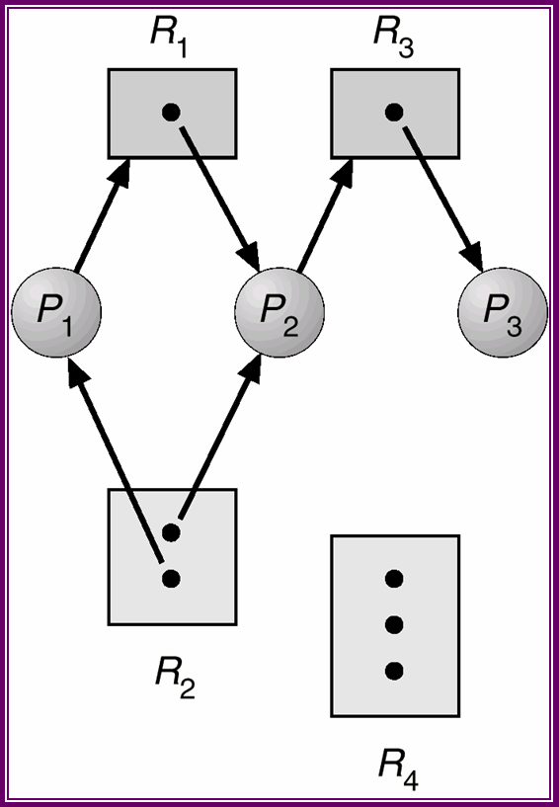
Resource Allocation/Manager
Computer system consists of many resources (CPU, Memory, I/O etc.).
In multiprogramming system, many programs are executes at a time.
Program required some resources to perform their task, operating system itself allocate these resource.
1.For CPU:- Operating System performs this activity with
Scheduling,
Timers and
Assigning the processes to the processors.
2.For Memory [MM]:- The memory management carried out with memory management unit (MMU) to achieve proper allocation of memory to program through the base and limit register.
3.For I/O:- Secondary storage management (HD, Magnetic Tape, CD ROM) is achieved by device drivers (system S/W) because each device is having different characteristics so they need proper synchronization through lock and release operation.

Slide 15


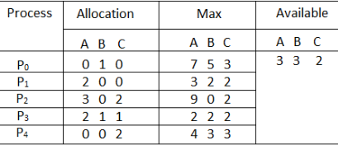
Accounting
In multiuser system, more than one user performs their operation/task on computer system.
Each user uses many resources many times as per requirement.
This log must be maintain by the OS to take proper decision while allocation and reallocation of resources.
Operating system keeps track of all users who logged in/into system, their usage of resource, their usage time and many more.
Operating system keeps track of all users and resources present at system so it can take a proper decision in future.
Accounting data is used for trend analysis, capacity planning, auditing and cost allocation. (Dead lock, Memory management and Security).

Slide 16


Protection
Protection is a main concern. Protections of resources is done by operating system.
Definition:-Protection refers to a mechanism or a way to control the access of programs, processes, or users to the resources defined by a computer system.
Operating system provide a protection like deciding owner of file, ensure that resource are used logically
Considering a computer system having multiple users and concurrent execution of multiple processes, the various processes must be protected from each other's activities.
Major activities of an operating system with respect to protection −
The OS ensures that all access to system resources is controlled.
The OS ensures that external I/O devices are protected from invalid access attempts.
The OS provides authentication features for each user by means of passwords
The OS provides locking mechanism for resource to protect misuse and access use
The OS provides access matrix for allocation of resources

Slide 17
Thank You
We will meet Soon!!!!!!!!!!

